Slide 1
School Management System
Instructor:
Aminul Islam
Assistant Professor
Computer Science & Engineering Discipline
Khulna University, Khulna
Team Members: Md Siam Ahmed - 230202
Md Masrafi Murtoja - 230207
Sobuj Chandra Paul - 230231

Slide 2
Project Overview
A web-based platform to manage school-related operations.
Simplify school management tasks.
Digitize student and teacher information.
Enable better communication.

Slide 3
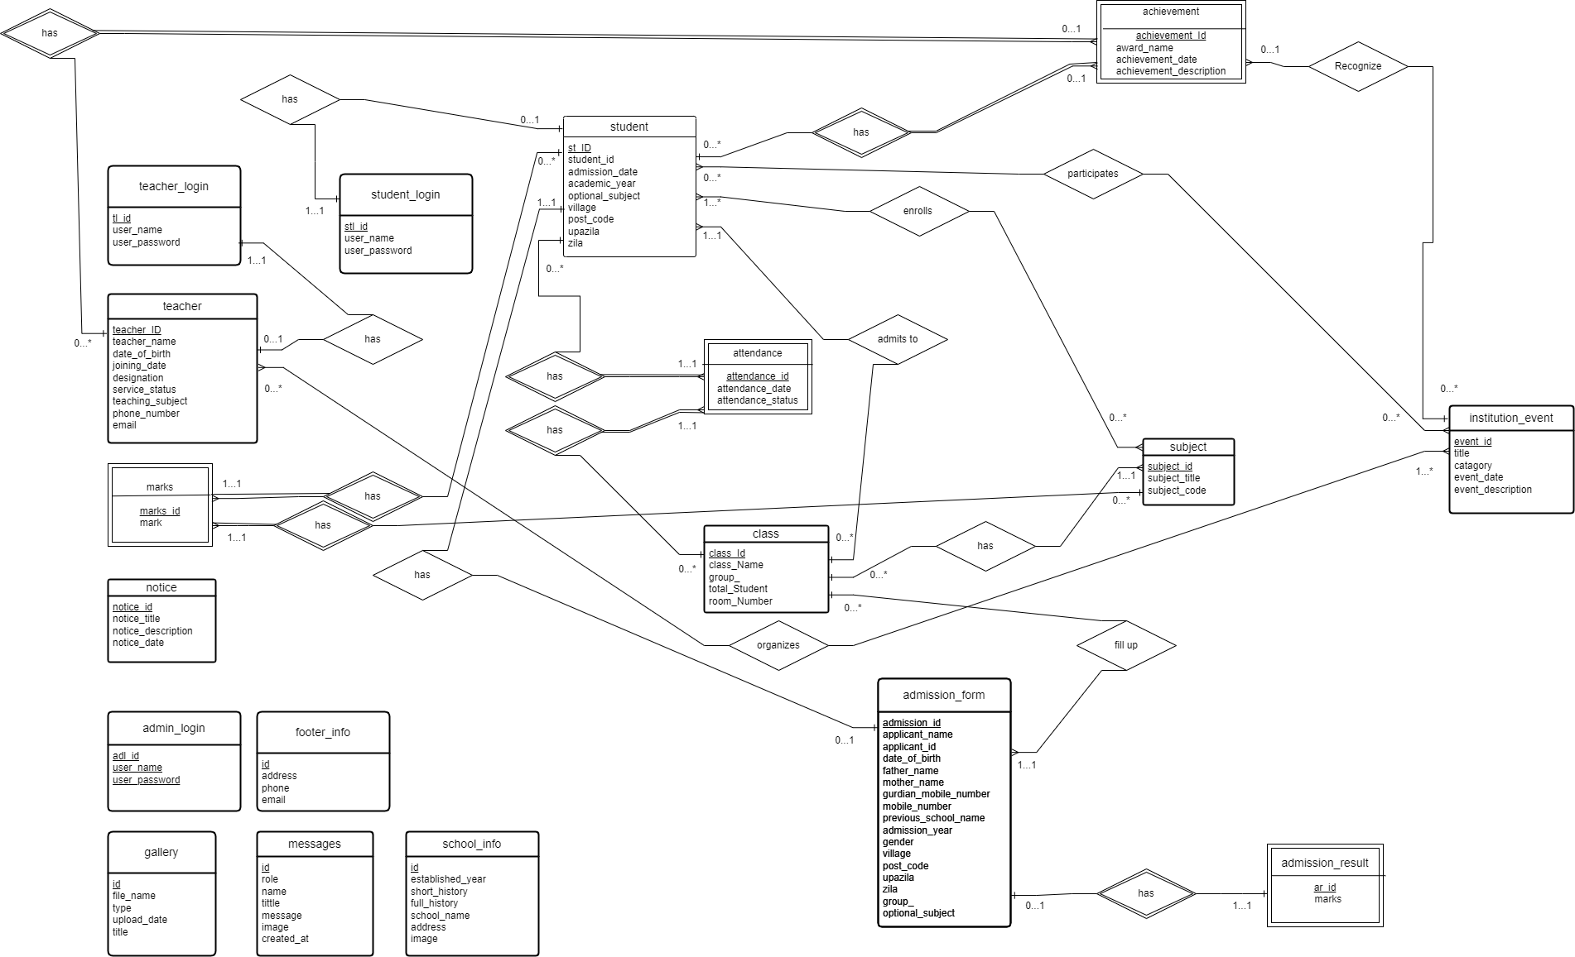
Entity Relationship Diagram

Slide 4
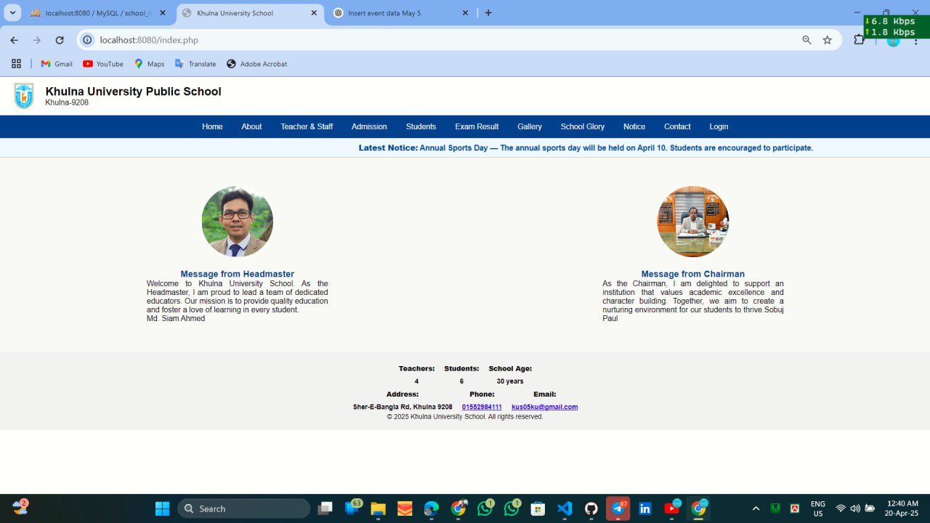
Features of Website
Homepage:

Slide 5
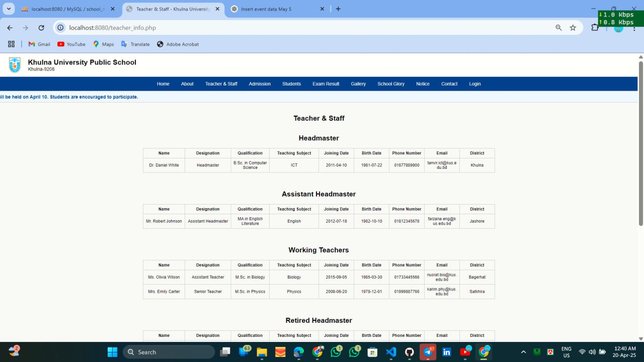
Features of Website
Teacher and stuff: The information about all the teacher and stuff.

Slide 6
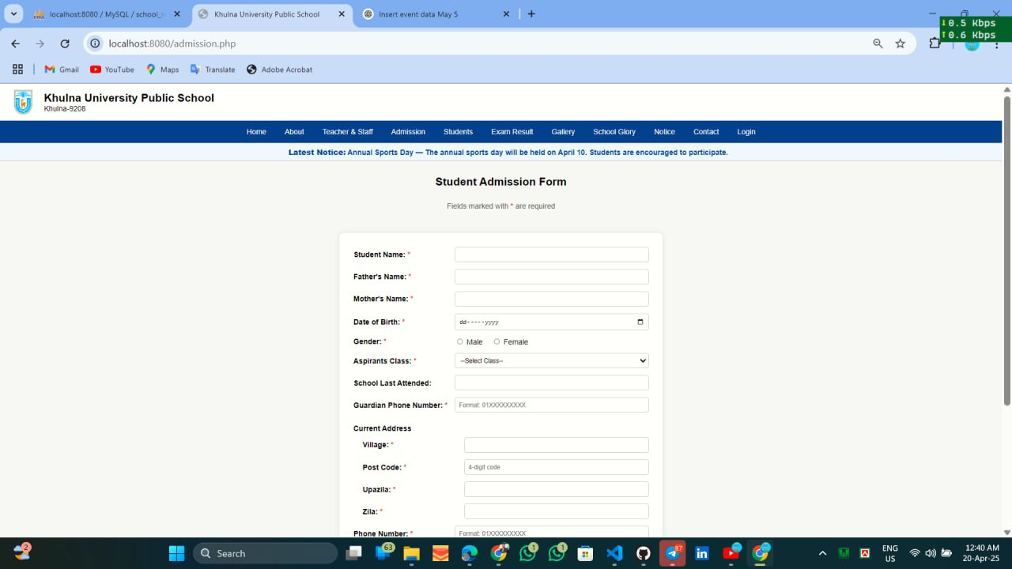
Features of Website
Student Admission Form:

Slide 7
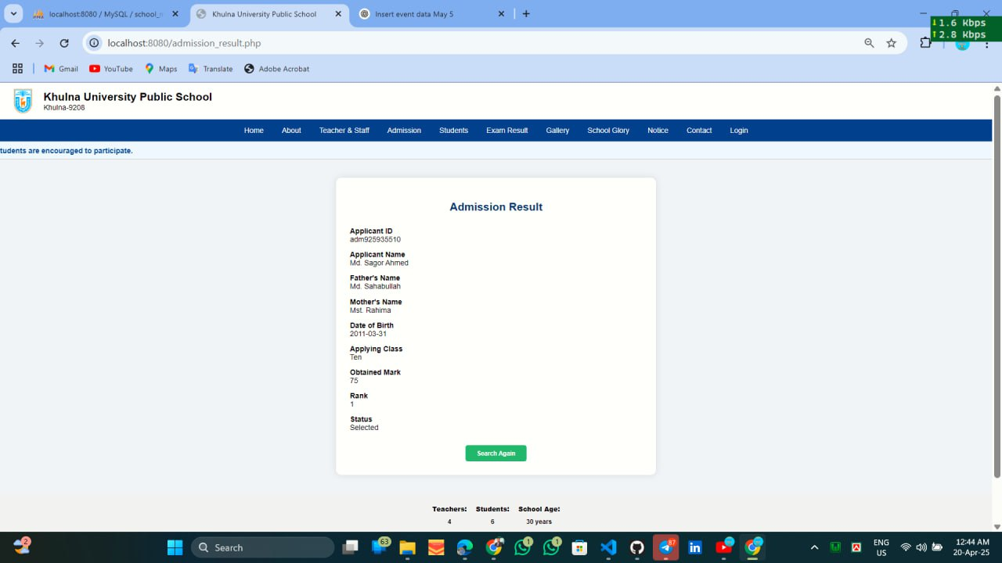
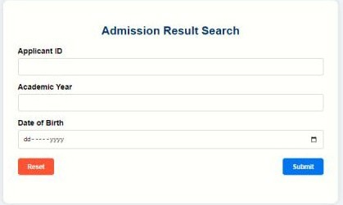
Features of Website
Admission Result:

Slide 8
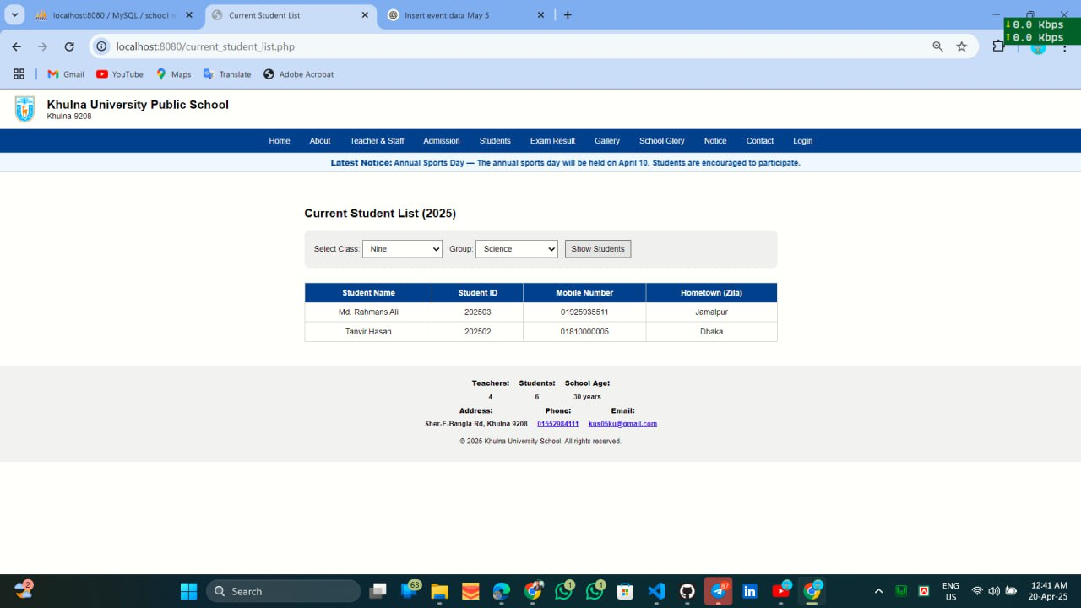
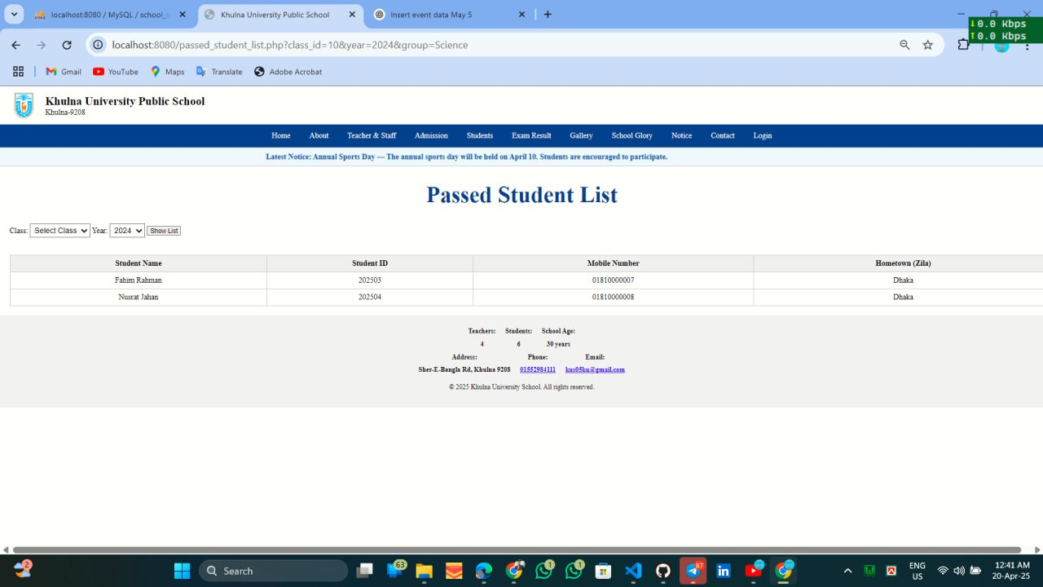
Features of Website
Records of Current Students and Passed Students.

Slide 9
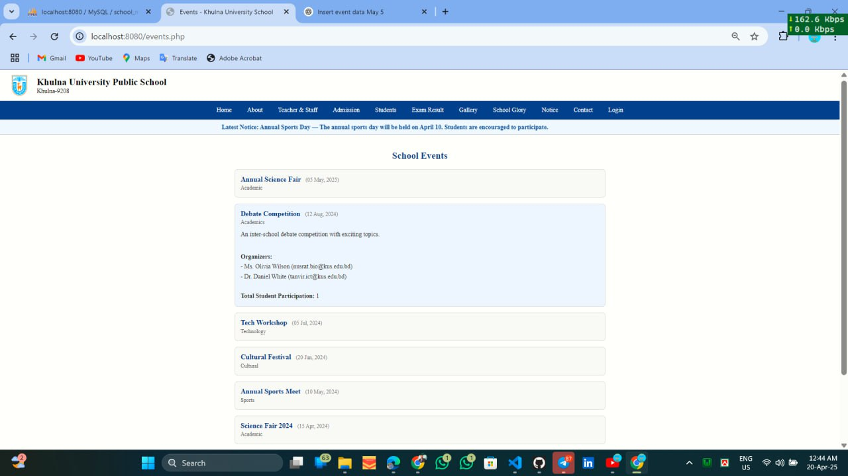
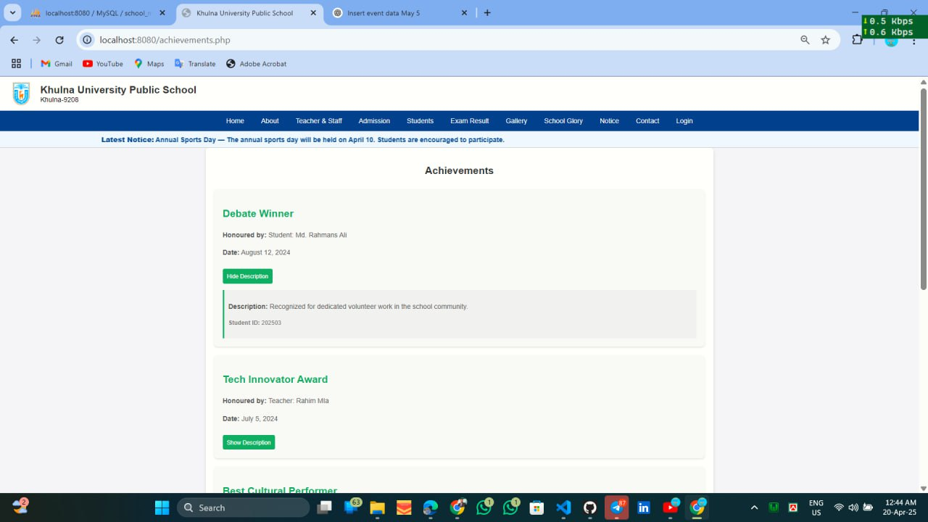
Features of Website
School Events and the Achievements

Slide 10
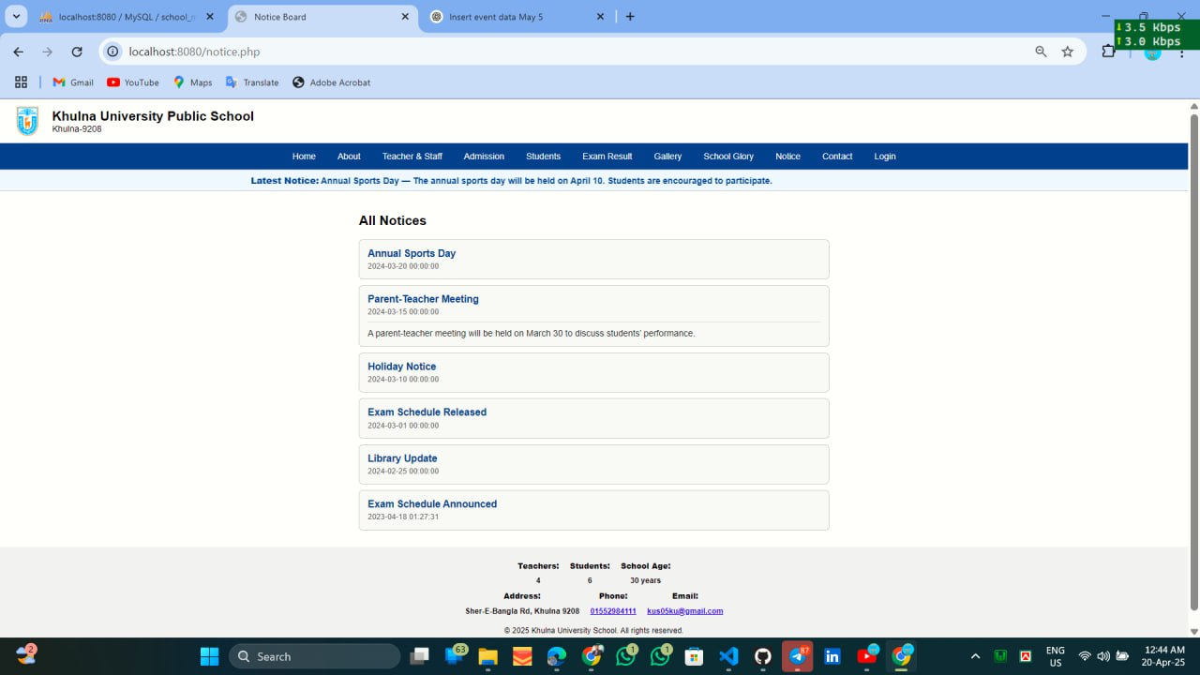
Features of Website
Notice

Slide 11
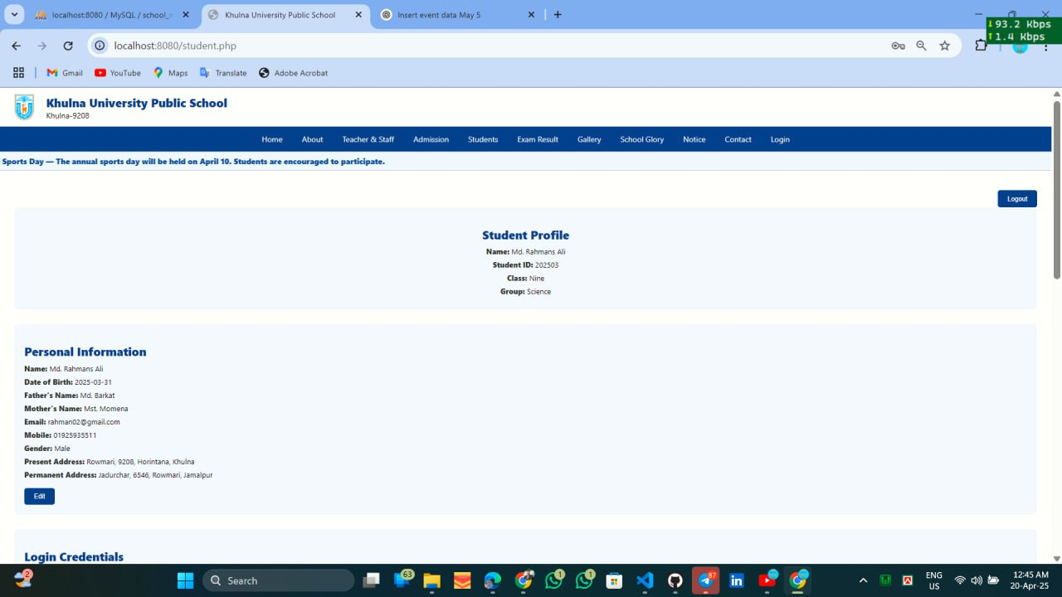
Special Features of Website
Student Profile:

Slide 12
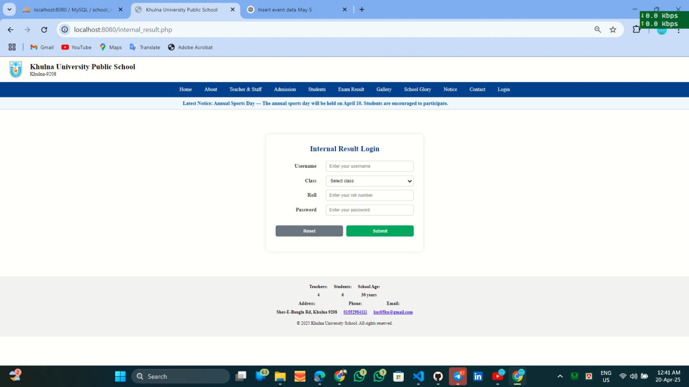
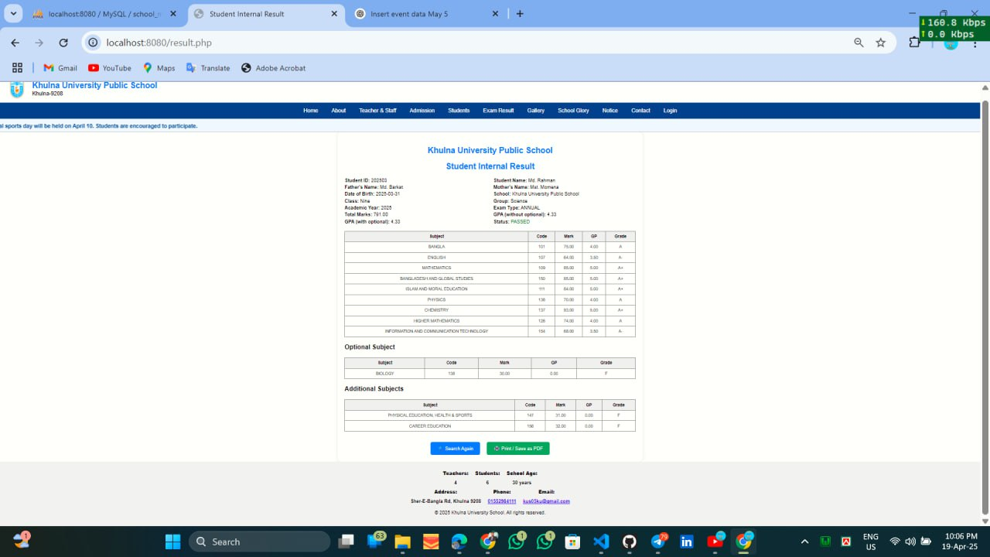
Special Features of Website
Enter necessary credentials to see your annual result.

Slide 13
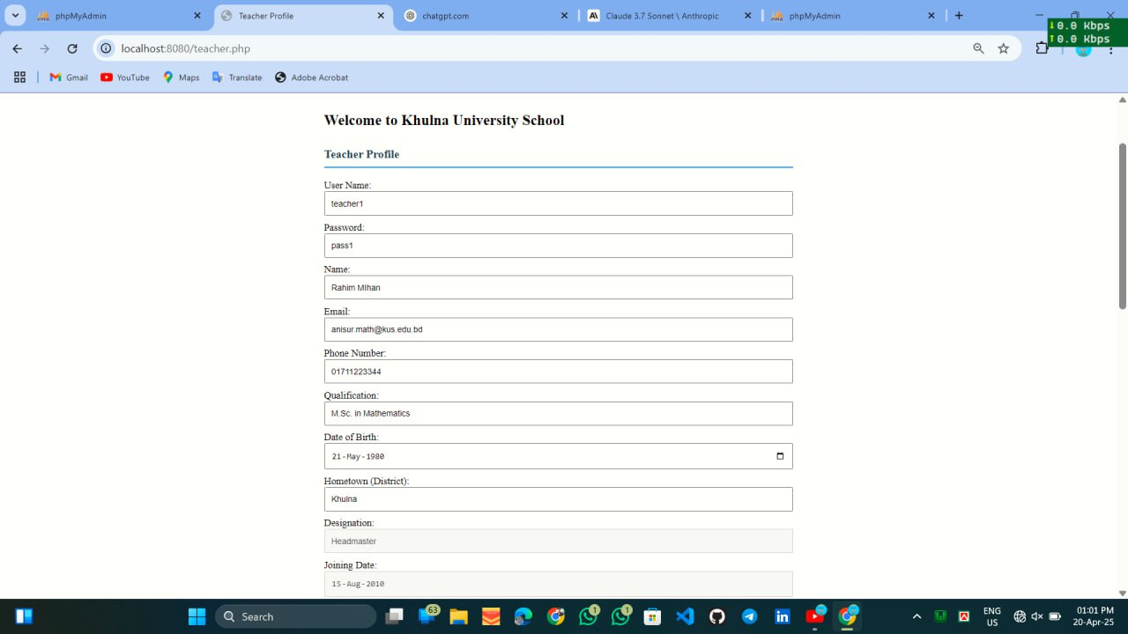
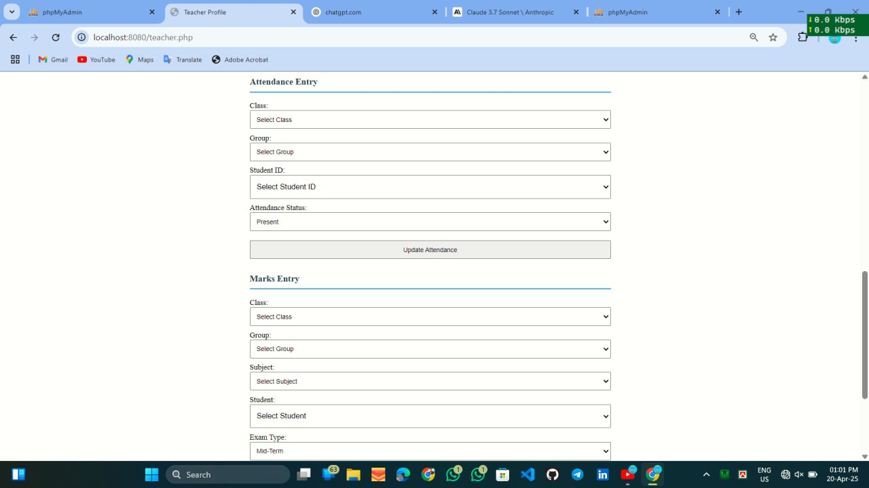
Special Features of Website
Teacher Profile , marks and attendance entry.

Slide 14
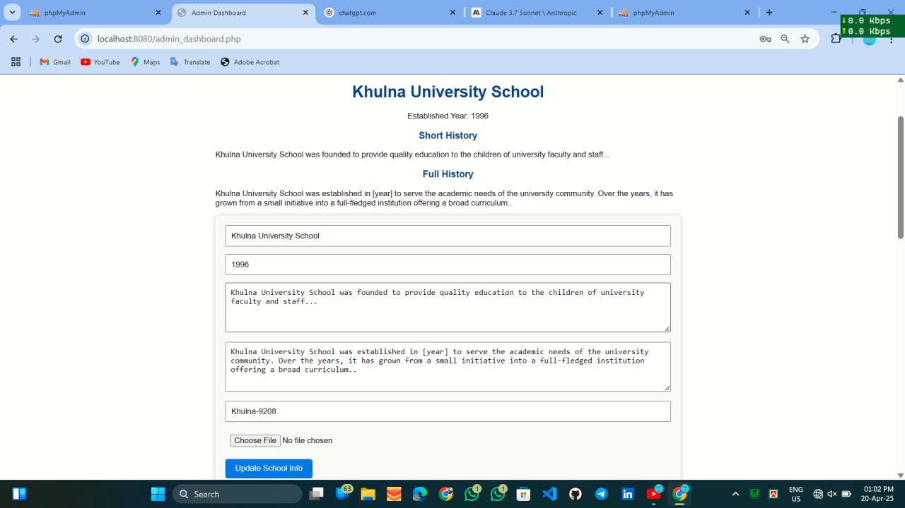
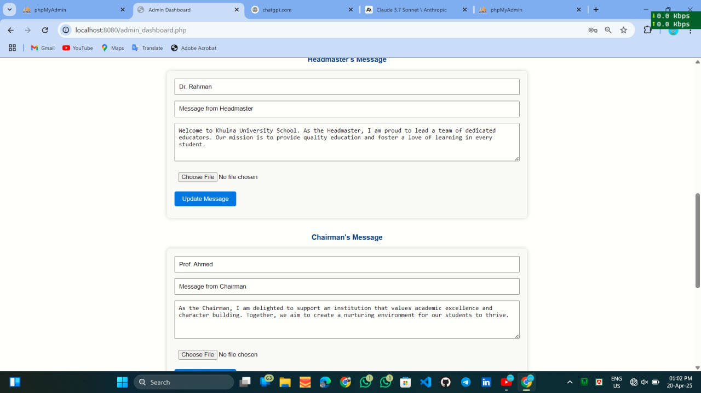
Special Features of Website
Admin Profile: Admin has the access to update everything.

Slide 15
Challenges Faced
Managing user role and access.
Making the system responsive.
Connect the interfaces with the database.
Validation from data.
Changes the alignment unexpectedly while zooming.

Slide 16
Future Enhancements
Email or sms notifications.
Store the photos and videos.
Generate printable reports.
Mobile app version.

Slide 17
Thank You

